Slide 1

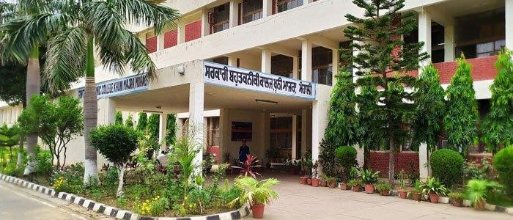
Govt. Polytechnic College, Mohali (Khunimajra)
Come to learn, Go to serve

Slide 2
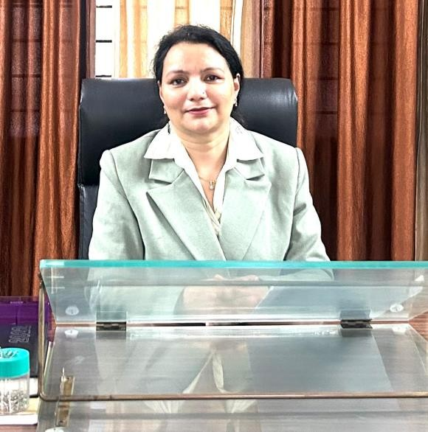
From the Desk of the Principal
Mrs. Raksha Kiran
At GPC Khunimajra we are committed to nurturing technically skilled, ethically strong, and socially responsible individuals. Our focus is on holistic education—blending academic excellence, practical skills, and core values to prepare students for global challenges. We believe in continuous learning, innovation, and building a strong foundation for every student’s future.

Slide 3
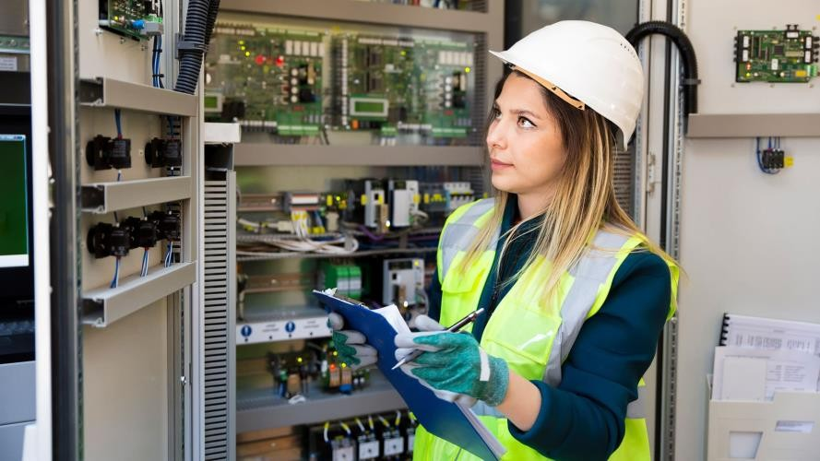
Courses offered
Our institute is affiliated with the Punjab State Board of Technical Education and Industrial Training (PSBTE&IT) and offers a variety of diploma programmes designed to build strong technical and professional skills.
Available Courses:
Civil Engineering
Computer Science and Engineering
Electrical Engineering
Electronics and Communication Engineering
Mechanical Engineering
Medical Laboratory Technology
Modern Office Practice
Information Technology
Chemical Engineering

Slide 4
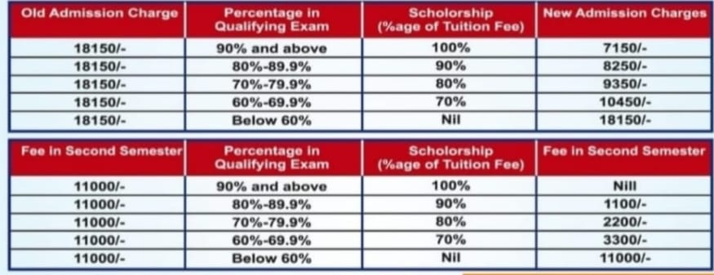
Fee Structure
The Chief Minister Scholarship Scheme, applicable only in government institutes, provides financial assistance to students of all categories based on their qualifying examination marks.
Full tuition fee waiver for SC category students with annual parental income below ₹2.5 lakhs

Slide 5
Admission Process
Based on 10th marks
Apply through PSBTE admission portal at http://punjabteched.net/
Participate in counselling or contact us directly at Govt Polytechnic College Khunimajra (Mohali)
Visit our Website gpckhunimajramohali.org

Slide 6
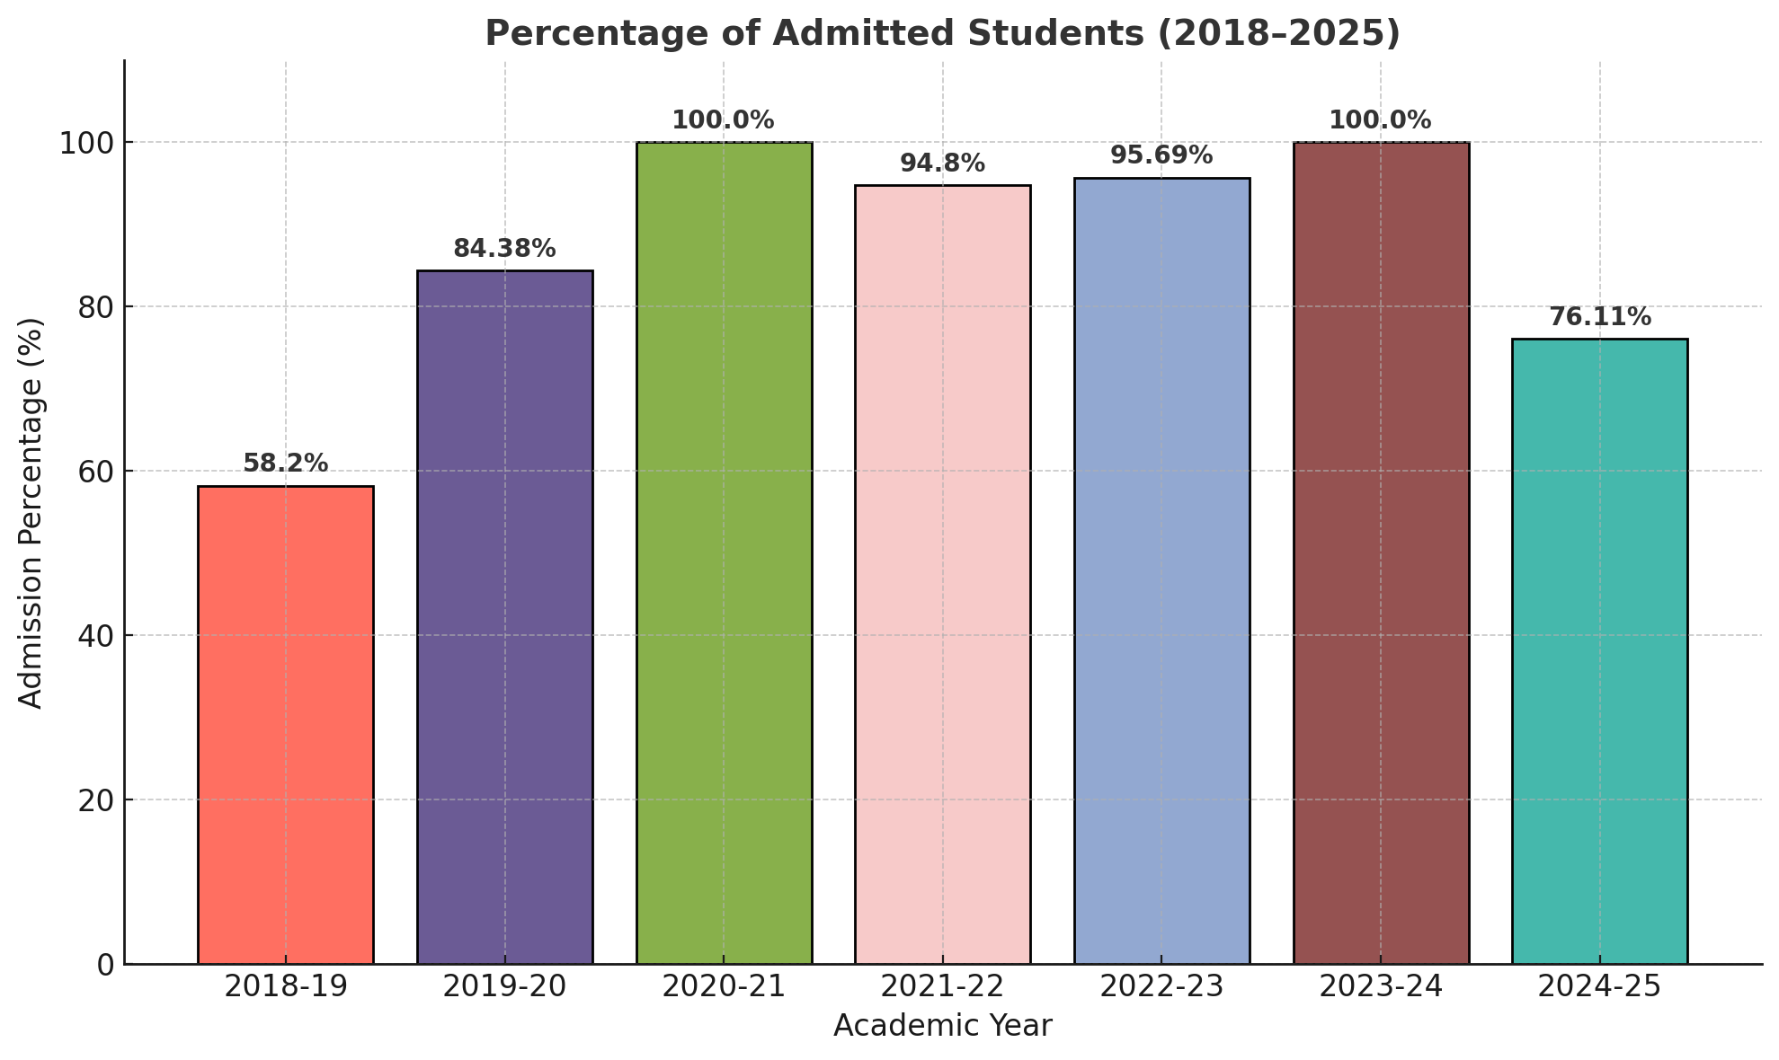
Percentage of admitted students

Slide 7
State level academic toppers(2024)
S.No | Rank | Name | Marks | Trade | Semester
2 | 2 | KARAMVEER SINGH | 714 | EE | 6TH
3 | 6 | SHALINI | 715 | MLT | 6TH
4 | 9 | HARJINDER KAUR | 710 | MLT | 6TH
5 | 9 | RUPINDER KAUR | 710 | MLT | 6TH
6 | 15 | ADITI GIRDHAR | 420 | MOP | 6TH
1 | 19 | PRIYANSHU RAI | 612 | CSE | 6TH
7 | 19 | AMAN KUMAR | 412 | MOP | 6TH
8 | 19 | HARNOOR KAUR | 412 | MOP | 6TH

Slide 8
Labs and Infrastructure

Slide 9
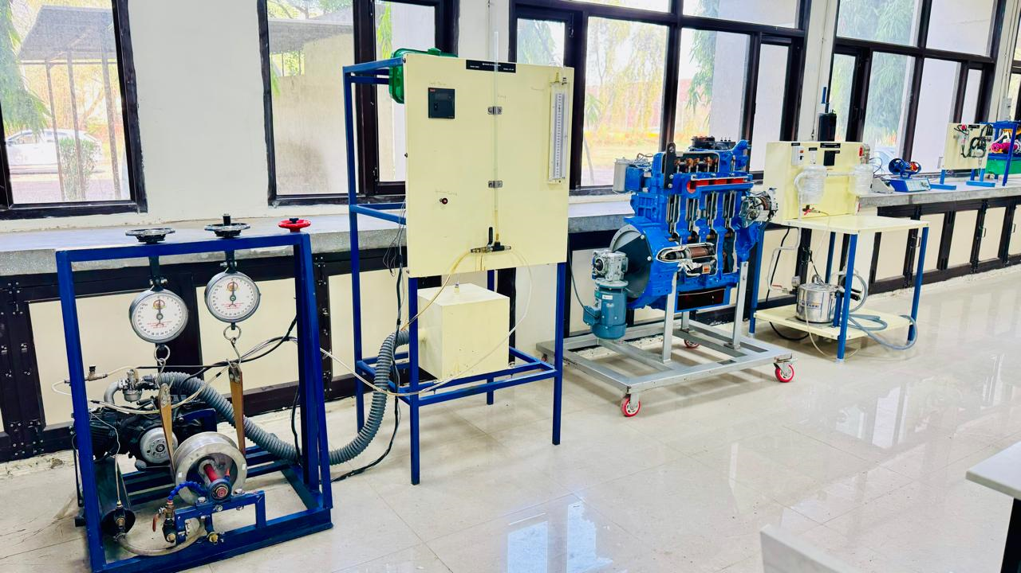
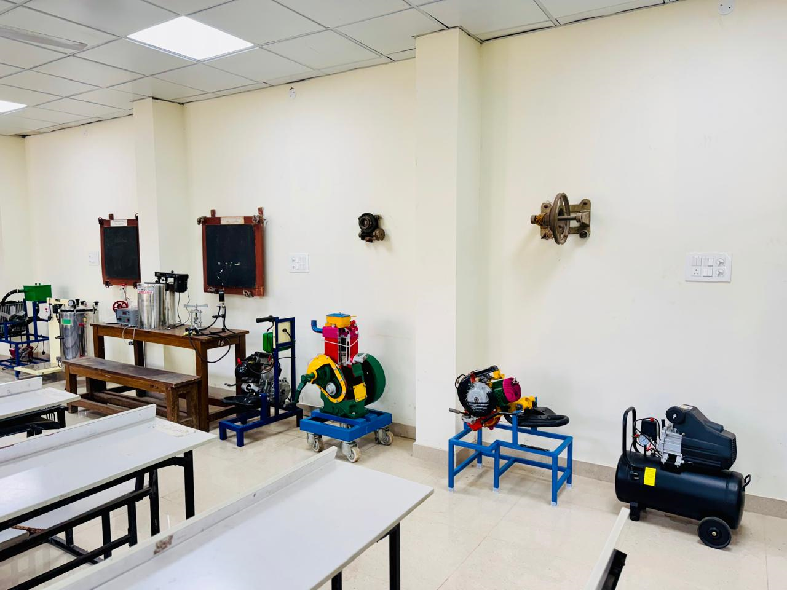
Mechanical Engineering Labs

Slide 10
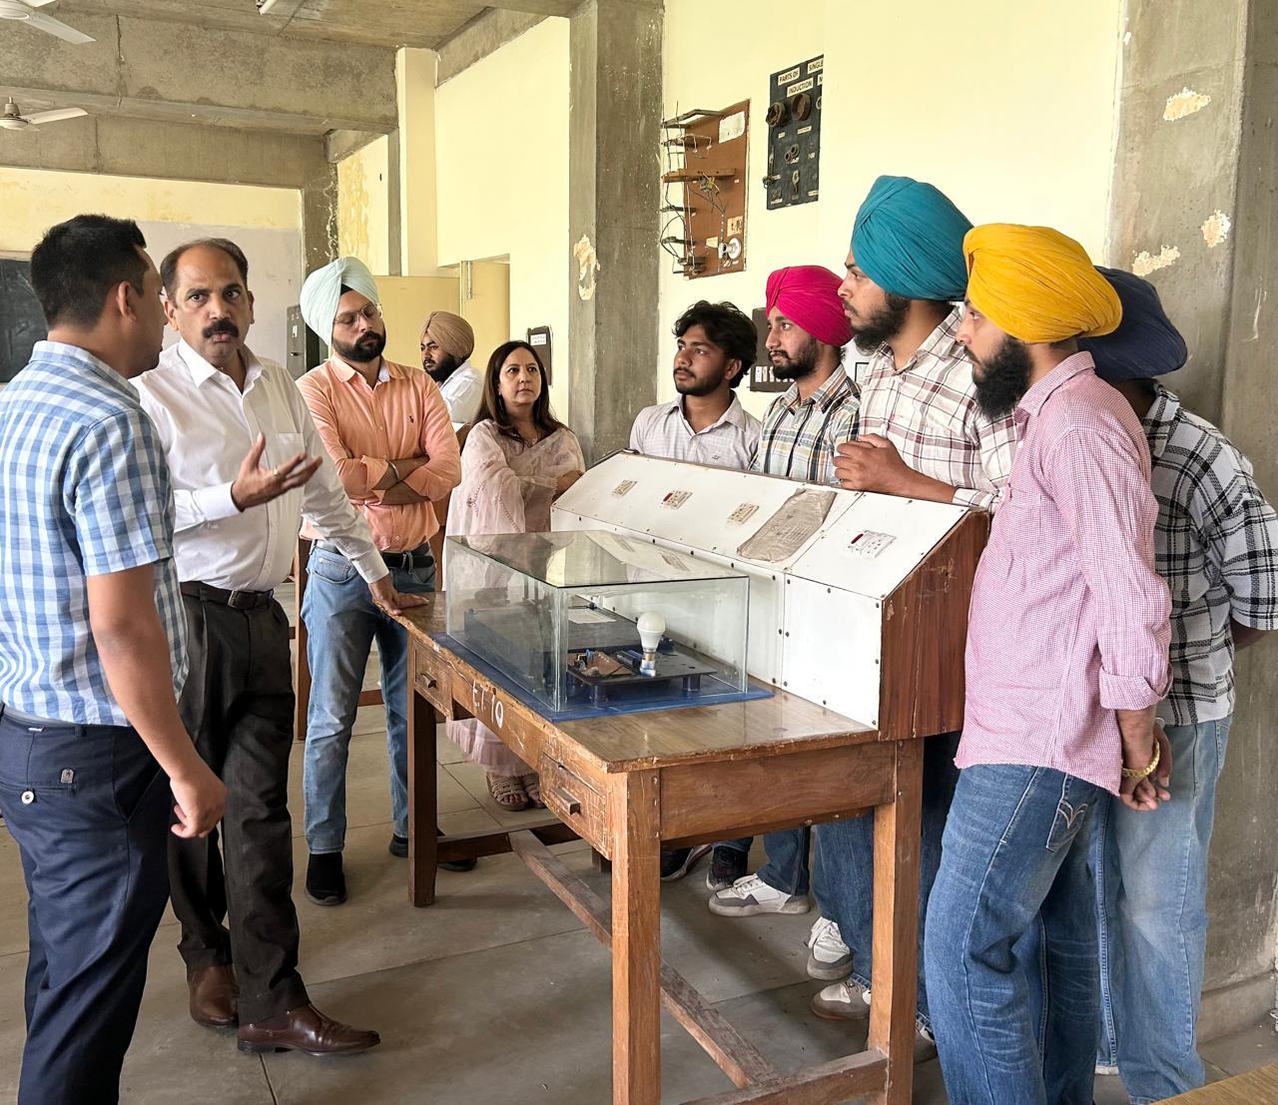
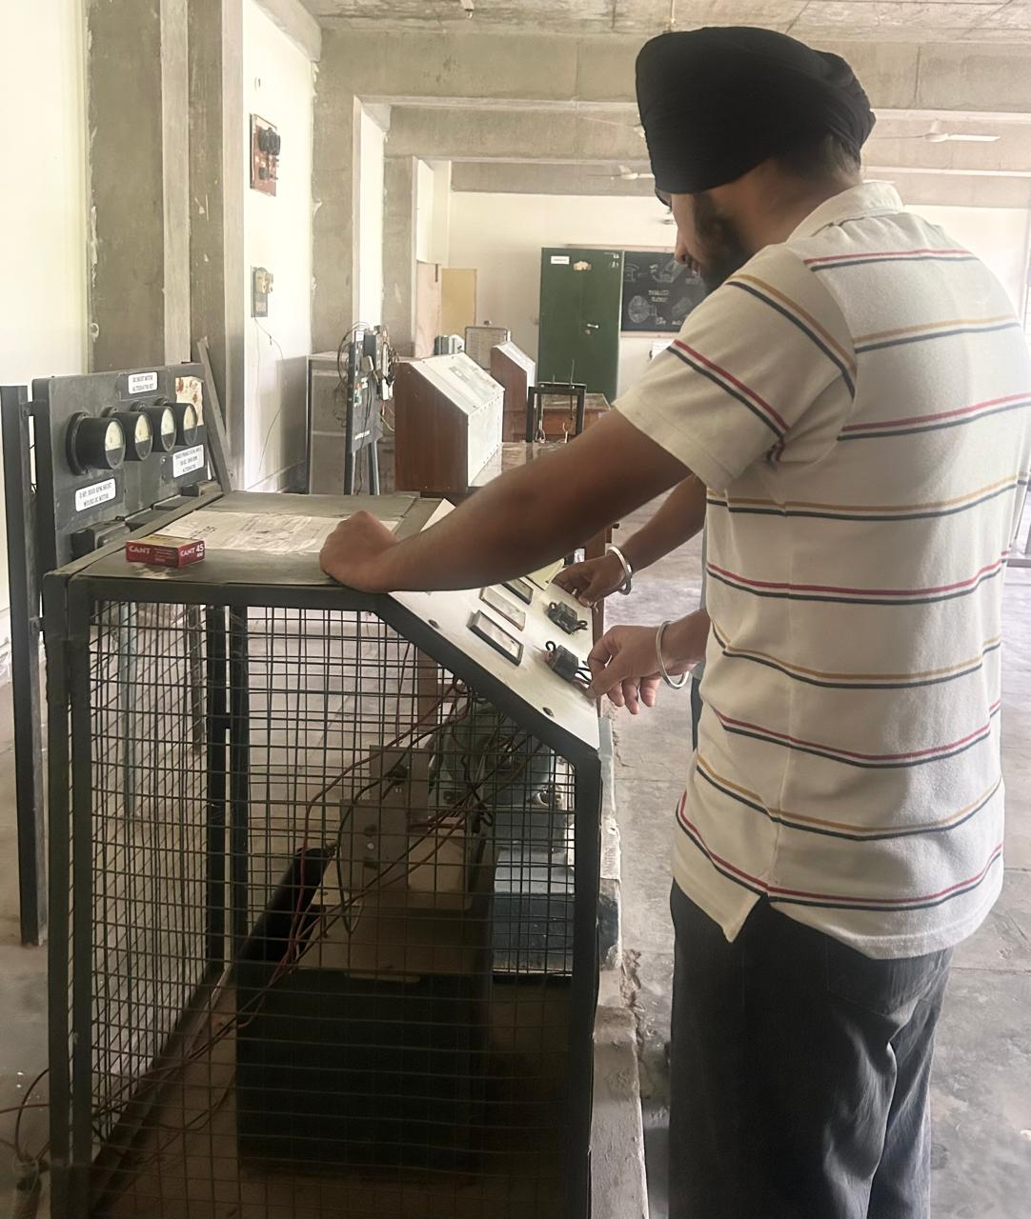
Electrical Engineering Labs

Slide 11
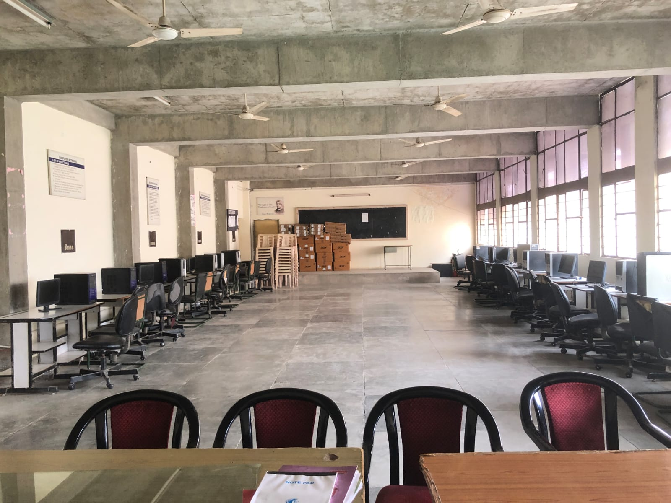
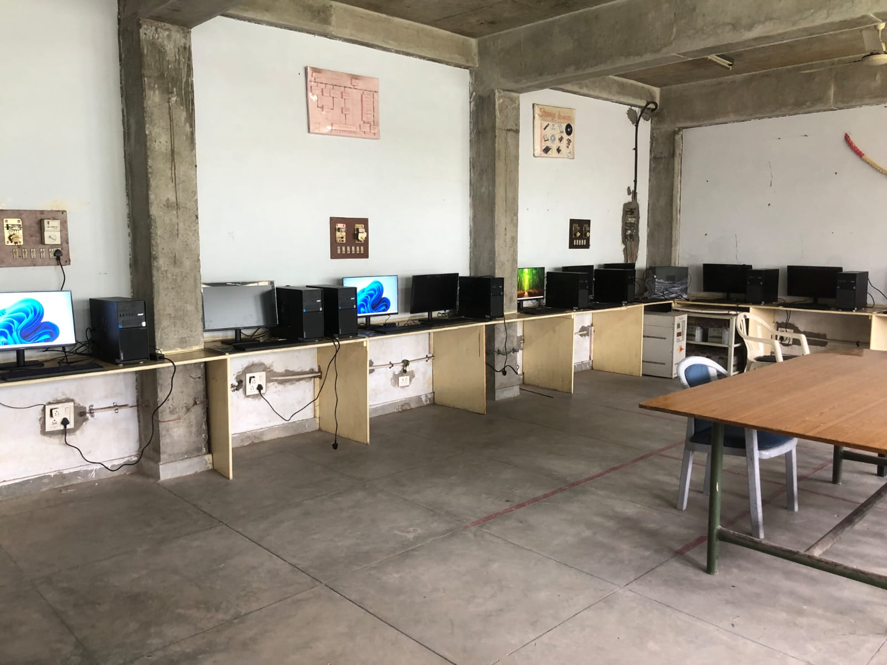
Computer Science Engineering Labs

Slide 12
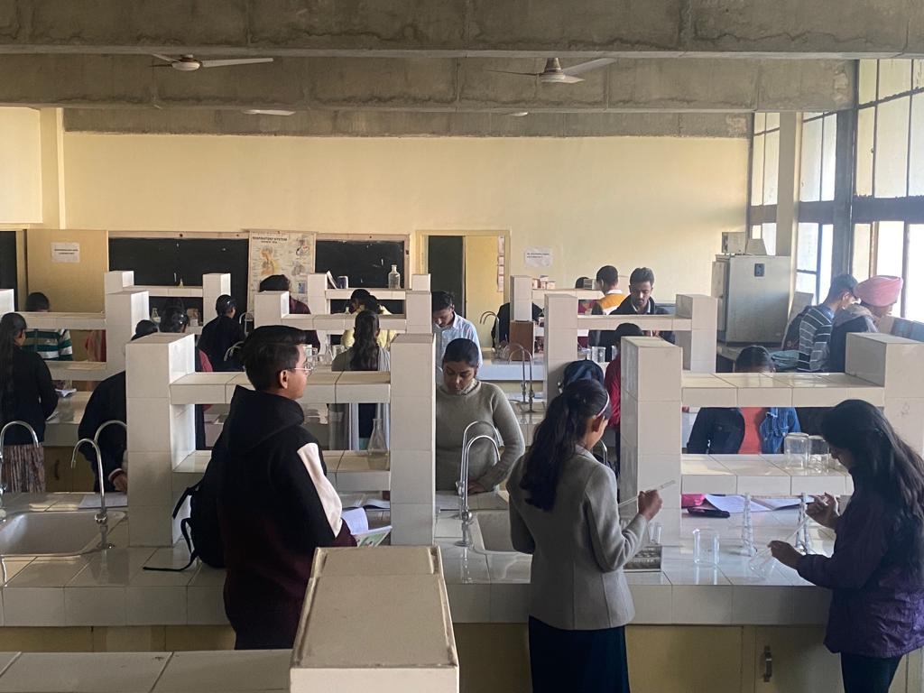
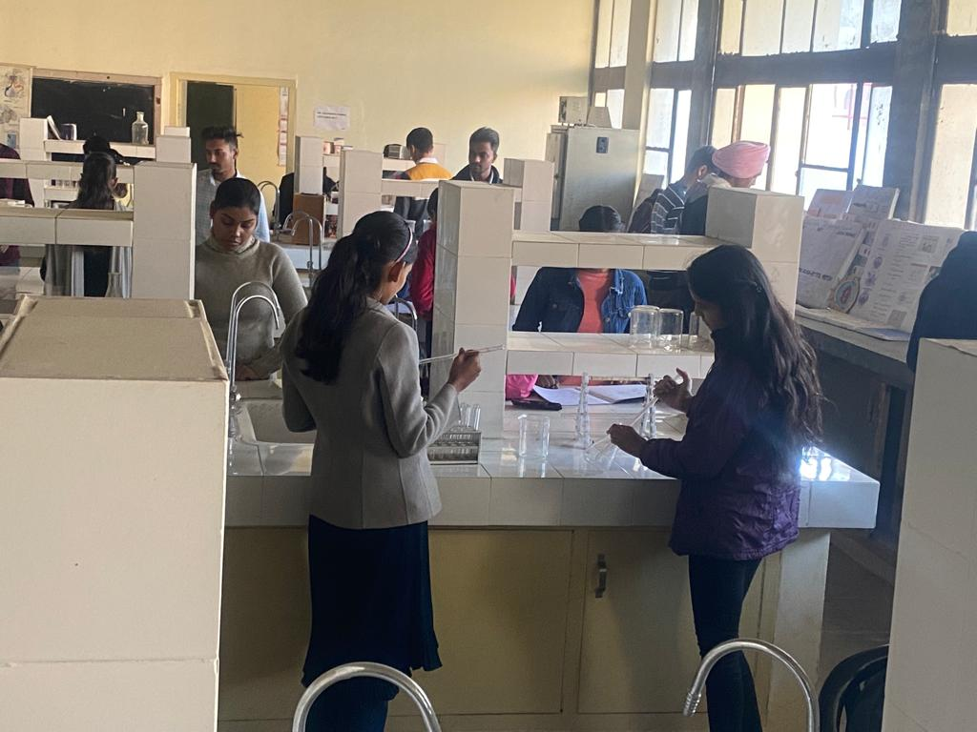
Medical Lab Technology Laboratories

Slide 13
Placements

Slide 14
Placement Status 2024-25
75 out of 95 placement-interested students have been successfully placed in the following companies:
Godrej Pvt. Ltd.
Cheema Boilers Pvt Ltd.
Mindcode Pvt Ltd.
Club Malwa, Mohali
Dr. Lal Path lab, Mohali
Global Infotech Consultants
Steel Strips Wheels, Derabassi
Swaraj Mahindra
Global Consultants
Walia Creative Arts, Patiala

Slide 15
Career Opportunities
Public Sector: PSPCL, Railways, Pollution Control Board, PGI
Private Sector: Godrej & Boyce Mfg. Co. Ltd., Swaraj Mahindra, Innovation Solutions, Cheema Boilers, Tenneco and many more
Higher studies: B.Tech, AMIE, or Competitive Exams
Entrepreneurship and self-employment avenues

Slide 16
MoU Signed With Prominent Organizations
College is the associated member of Mohali Industrial Association(MIA) with 600 industries under its umbrella. They provide support and service for placement, expert lecture and internship.
One MoU has been signed with CTR ludhiana for the establishment of the extension centre of CTR ludhiana in the college campus.

Slide 17
Teaching Faculty
        Twenty staff members hold Ph.D or Masters qualification.
Name of the Department | Total number of faculty members
 | HOD | Lecturer/Sen Lect.
Applied Sciences | 1 | 6
Civil Engineering |  | 6
Computer Science Engineering+IT | 1 | 5
Electrical Engineering | 1 | 4
Mechanical Engineering | 1 | 5
Medical Lab Technology | 1 | 4
Modern Office Practice | 1 | 3
Electronics & Communication Engineering | 1 | 2

Slide 18
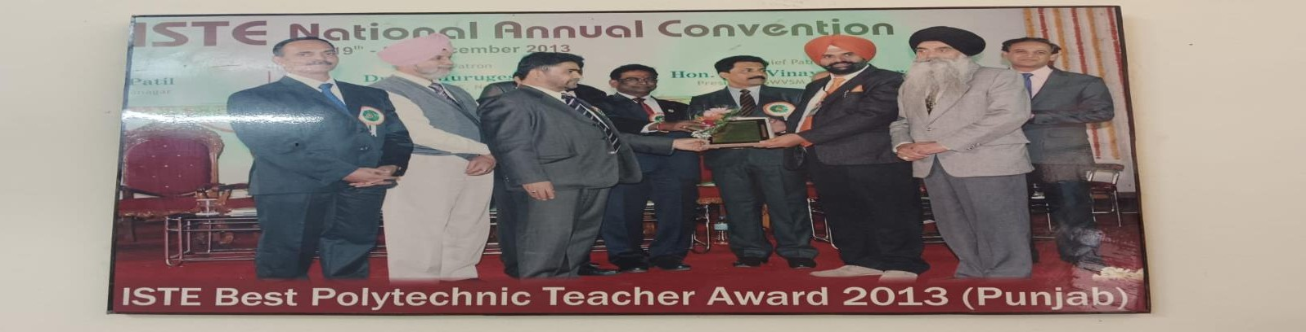
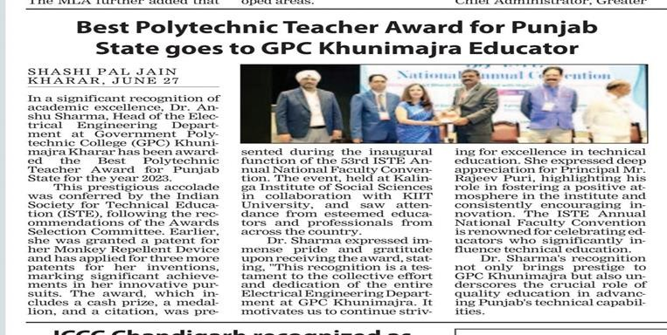
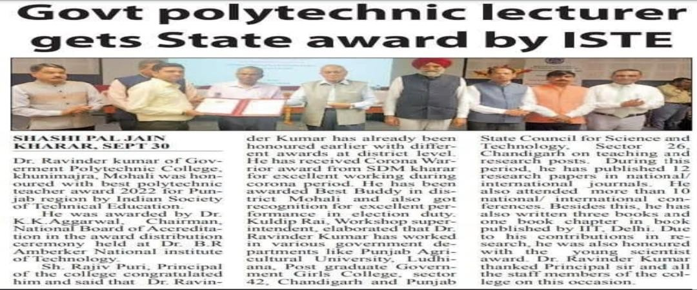
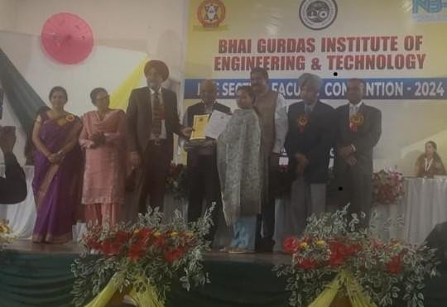
Academic Excellence : Our Awarded Faculty
Mr. Gurbakshish ,officer Incharge Civil got Best polytechnic Teacher award in 2013 for his outstanding performance
Dr. Anshu Sharma, Head of the Department of Electrical Engineering, was honored with the Best Teacher Award in 2024 for her exemplary leadership and commitment to academic excellence.
Dr.. Ravinder Kumar, Lecturer in MLT, was honored with the Best Teacher Award in 2021 for his outstanding dedication and excellence in teaching
Dr. Anu Bala, Physics lecturer got best polytechnic teacher award for her exceptional performance at a ISTE section convention held on October 15, 2024

Slide 19
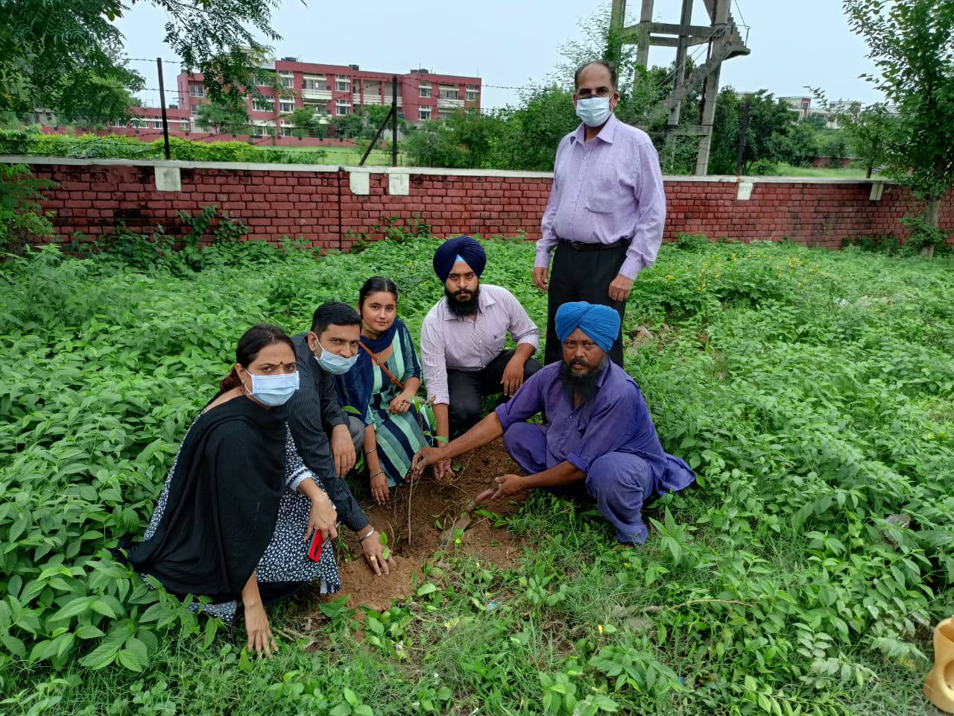
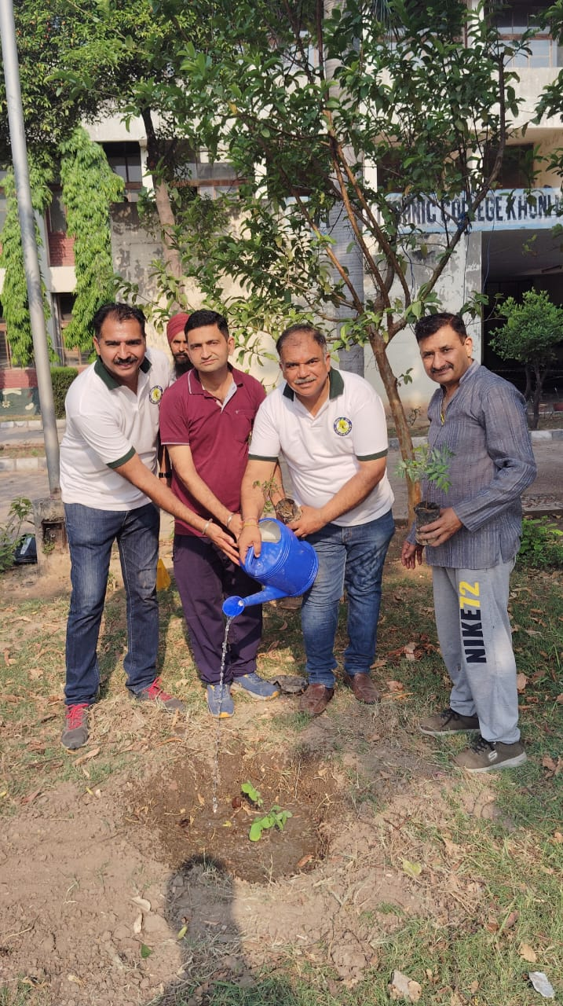
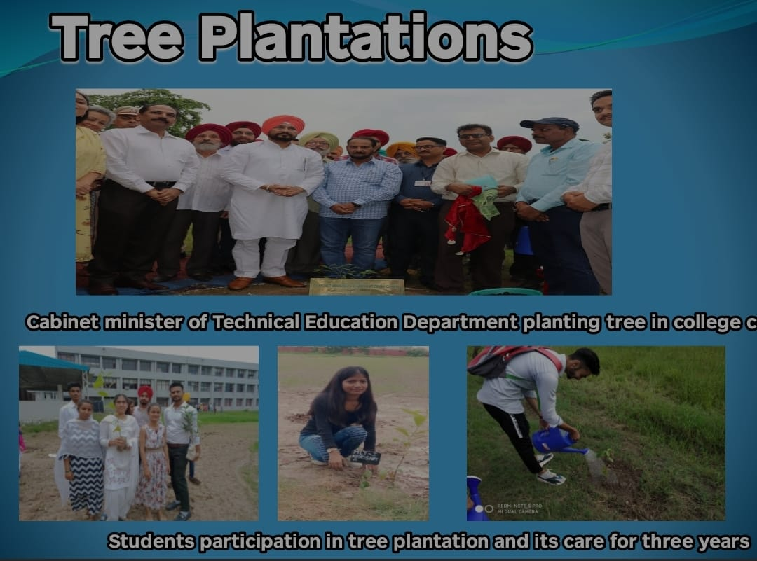
NSS Activities

Slide 20
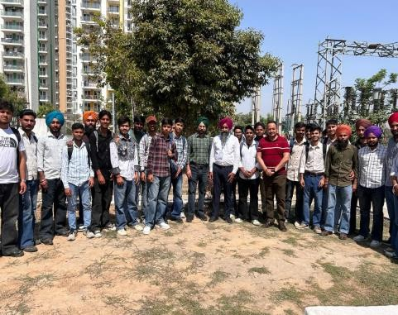
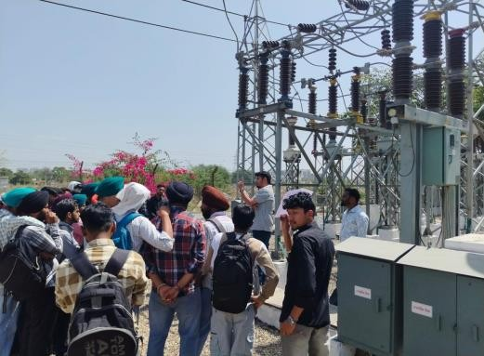
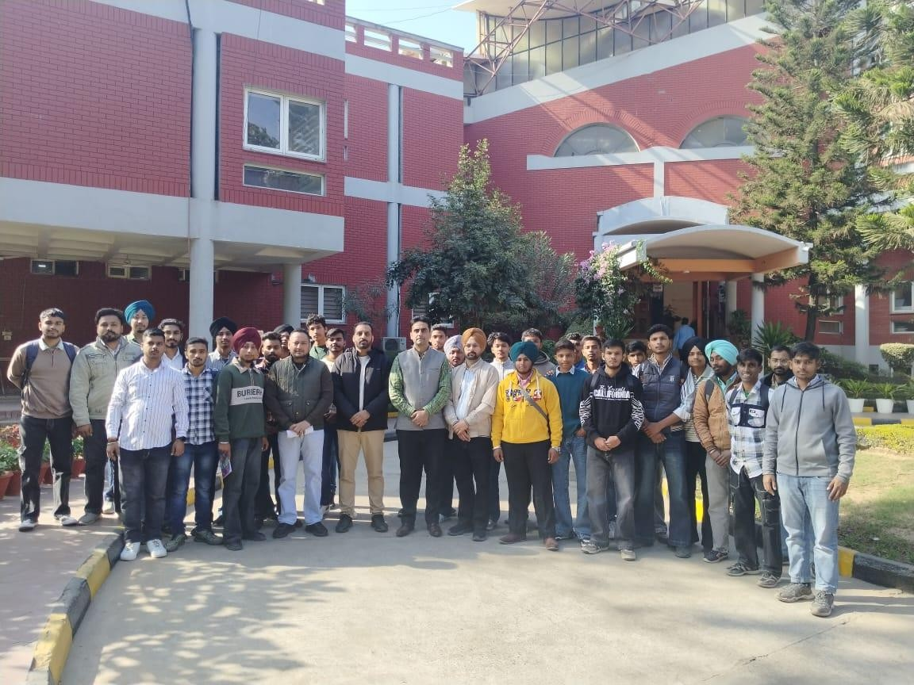
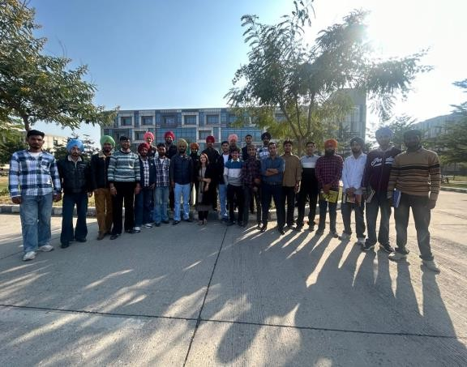
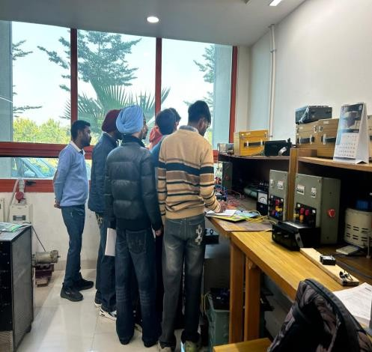
Industrial visits for experential learning
Industrial Visit to 66/11 kV Substation – Real World Power Systems
PEDA (Punjab Energy Development Agency) Insights into Renewable Energy Initiatives
Educational Visit to IIT Ropar
Innovation & Research Exposure

Slide 21
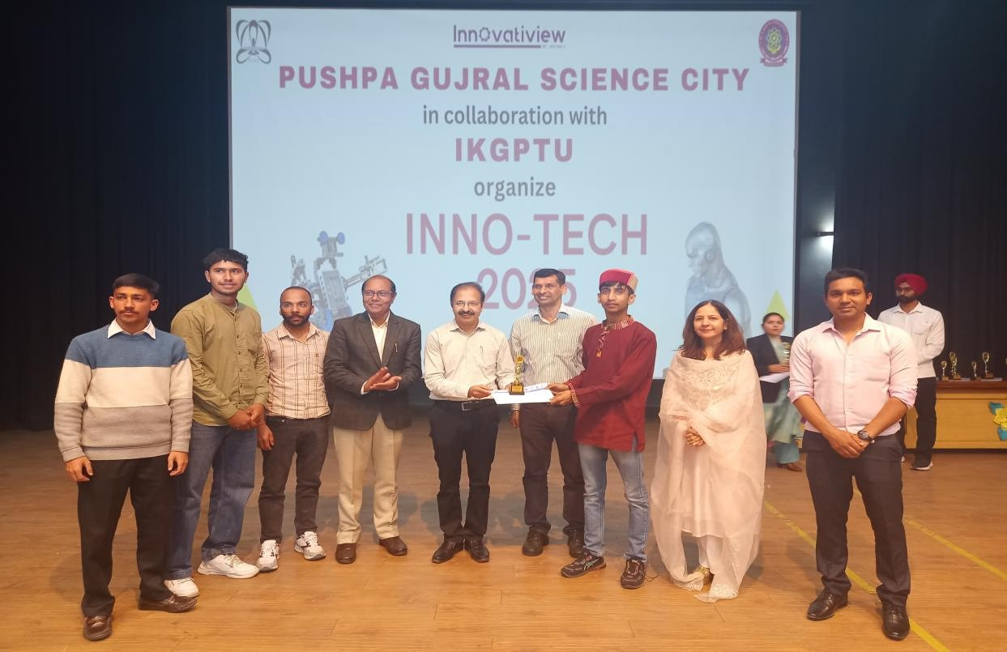
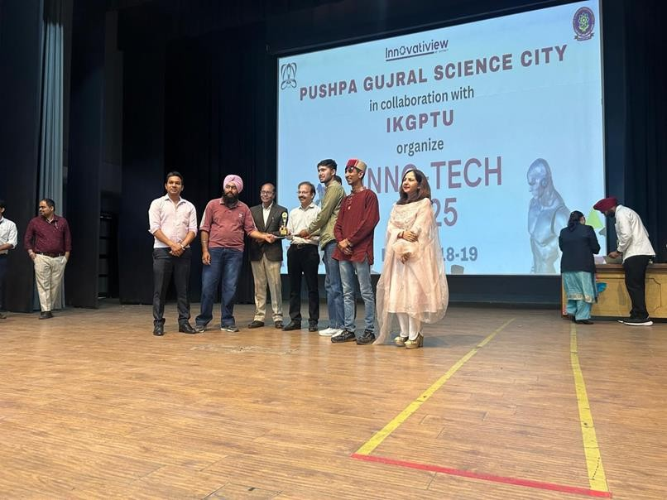
State-Level Inno-tech 2025 held at PGSC, Kapurthala
The innovative project “Transmission Line Fault Detection and Monitoring System” secured Third Prize. The project addressed real-time power system fault monitoring.
The project “Solar Cracker” won Second Prize. The project focused on eco- friendly energy applications

Slide 22
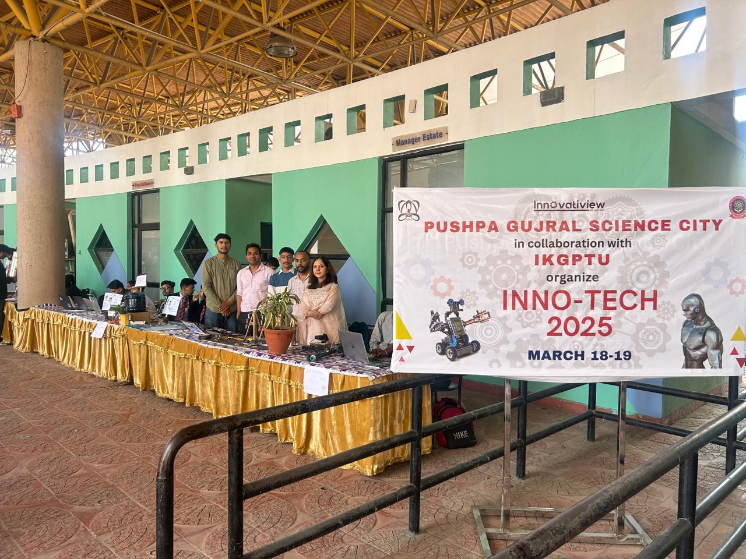
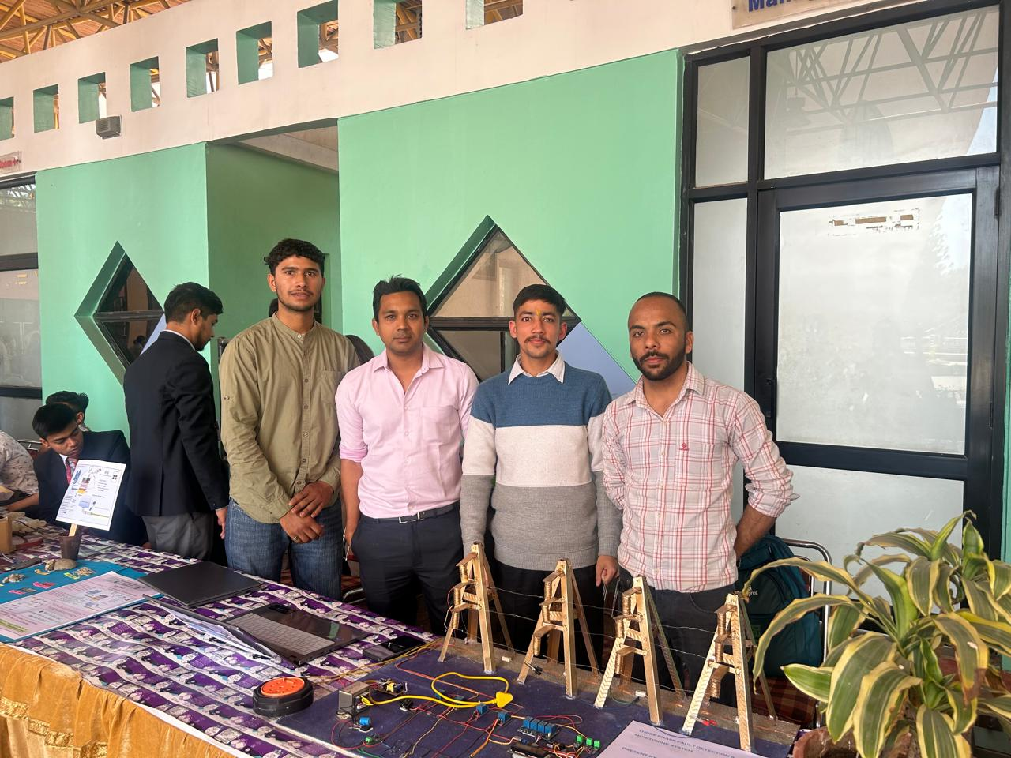
State Level PTIS Tech Fest 2025 held in Amritsar
GPC Khunimajra triumphed at the state-level PTIS TechFest, winning seven awards. Electrical Engg., Mechanical Engg, and MOP departments secured 1st prizes in the project competition, while the Applied Science department secured 3rd prize. In the paper presentation category, Electrical Engineering secured 1st position, Mechanical Engineering secured 2nd, and MOP secured 3rd position.

Slide 23
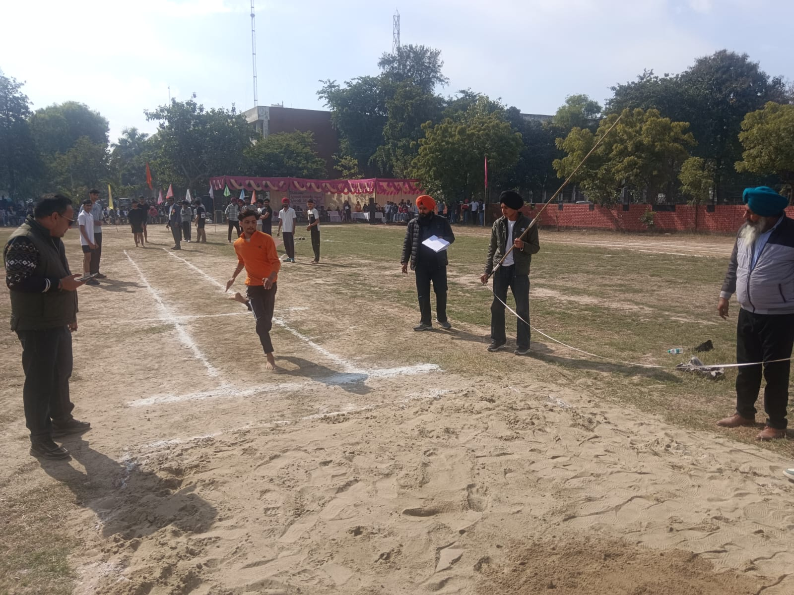
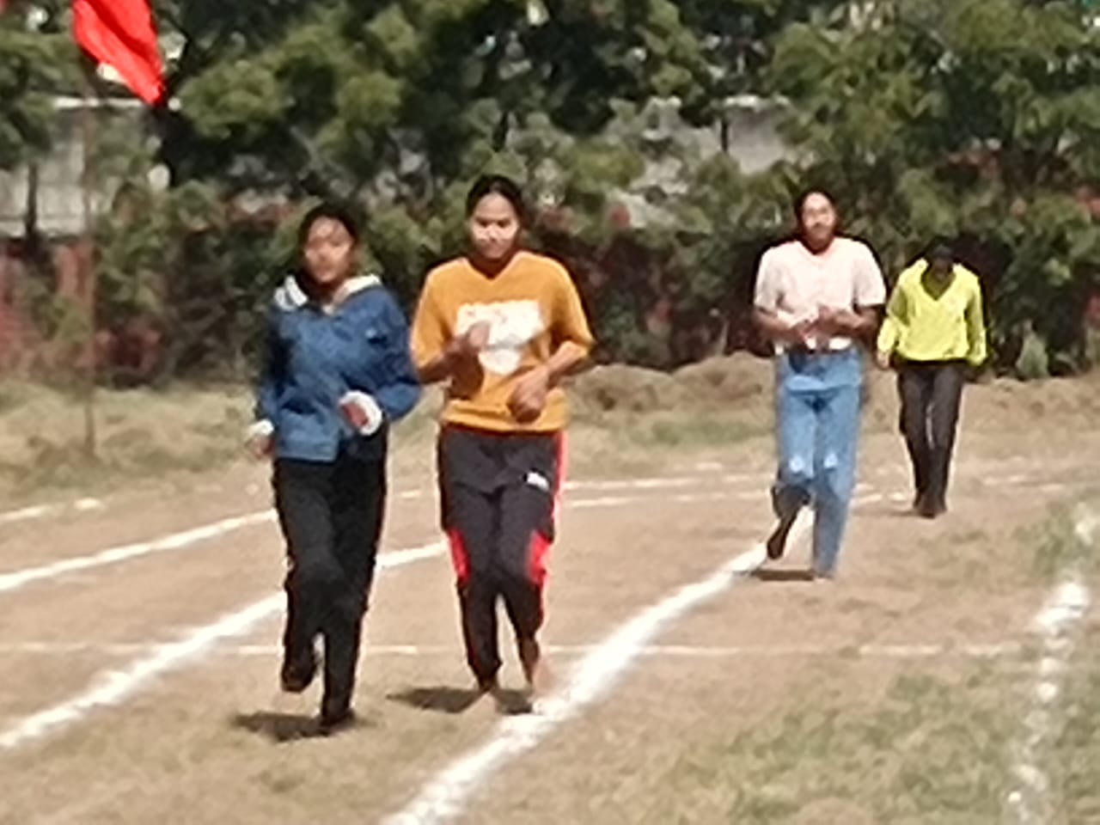
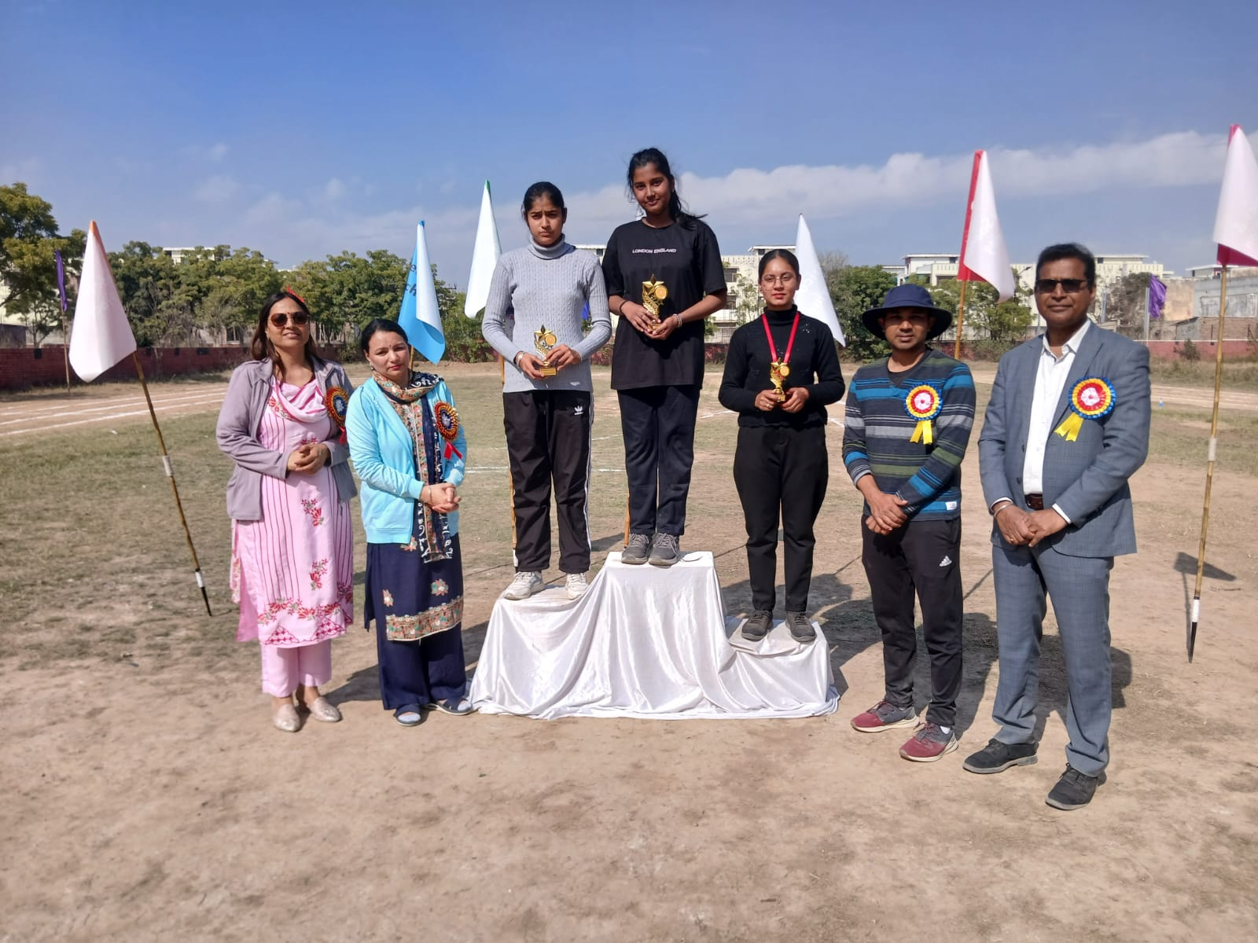
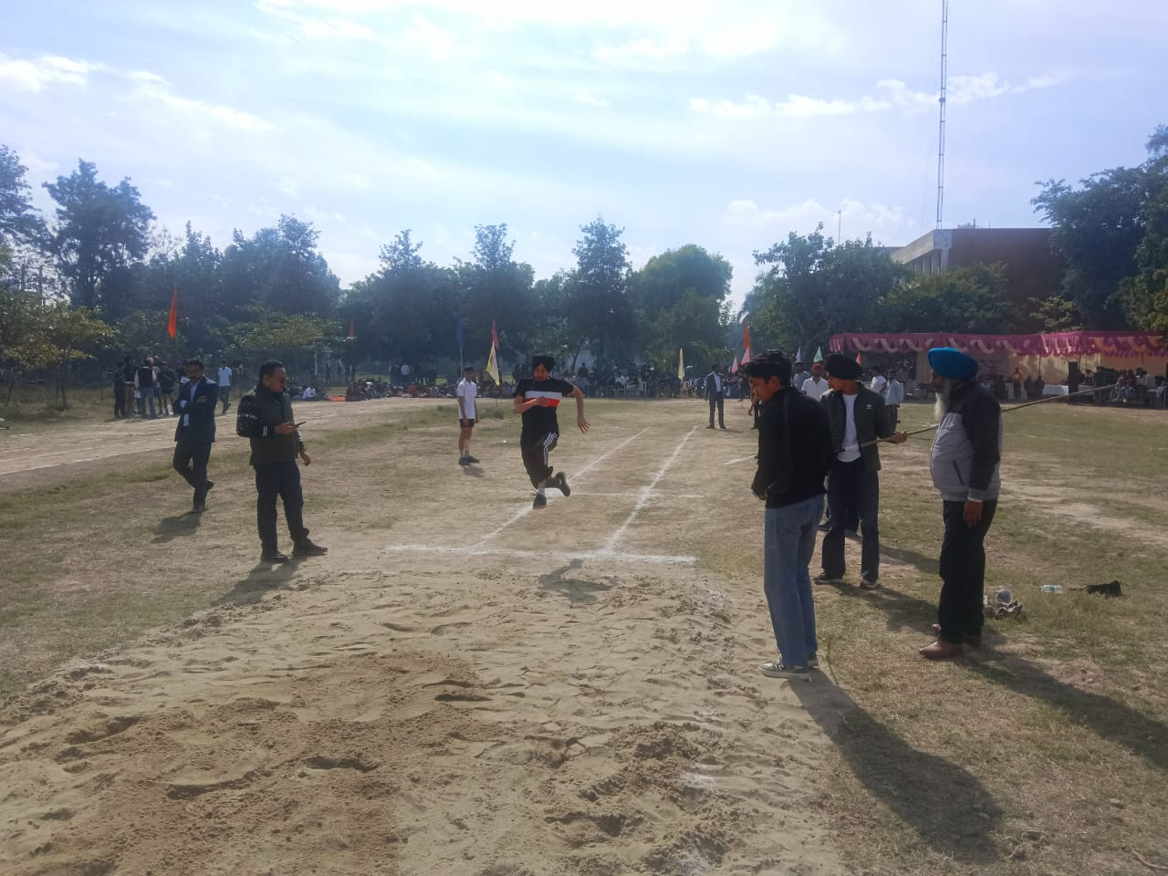
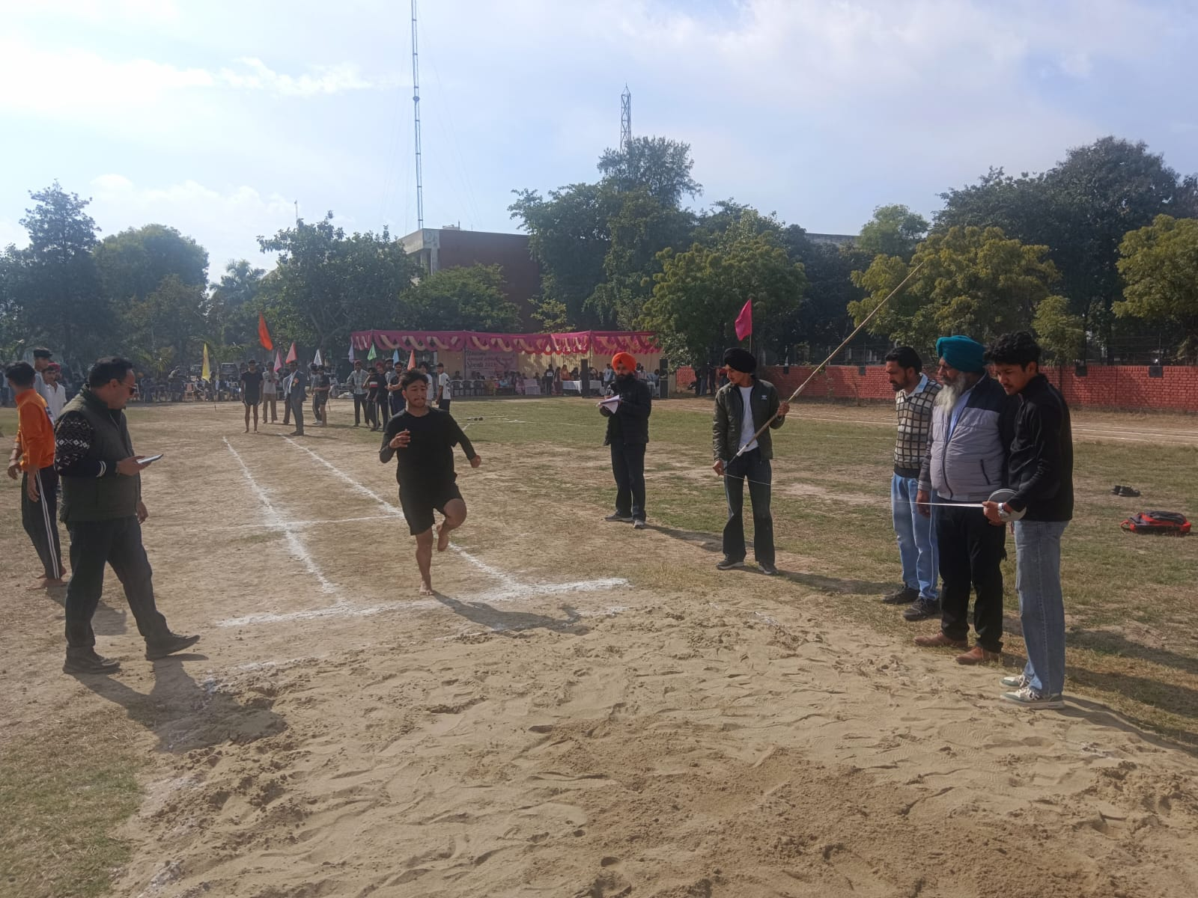
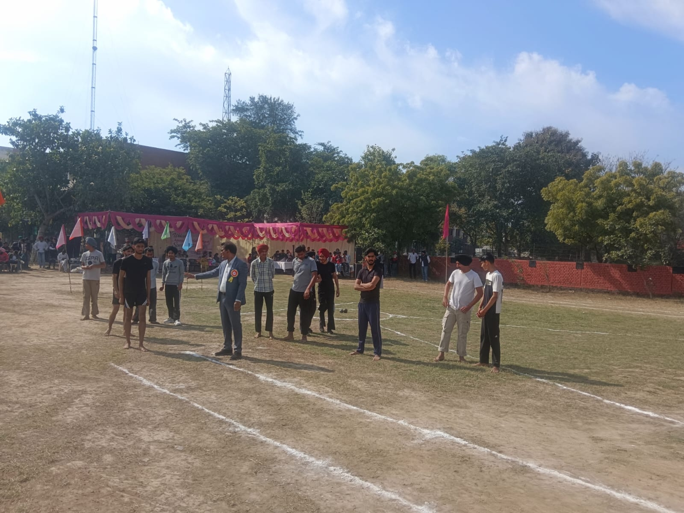
Athletic meet 2025

Slide 24
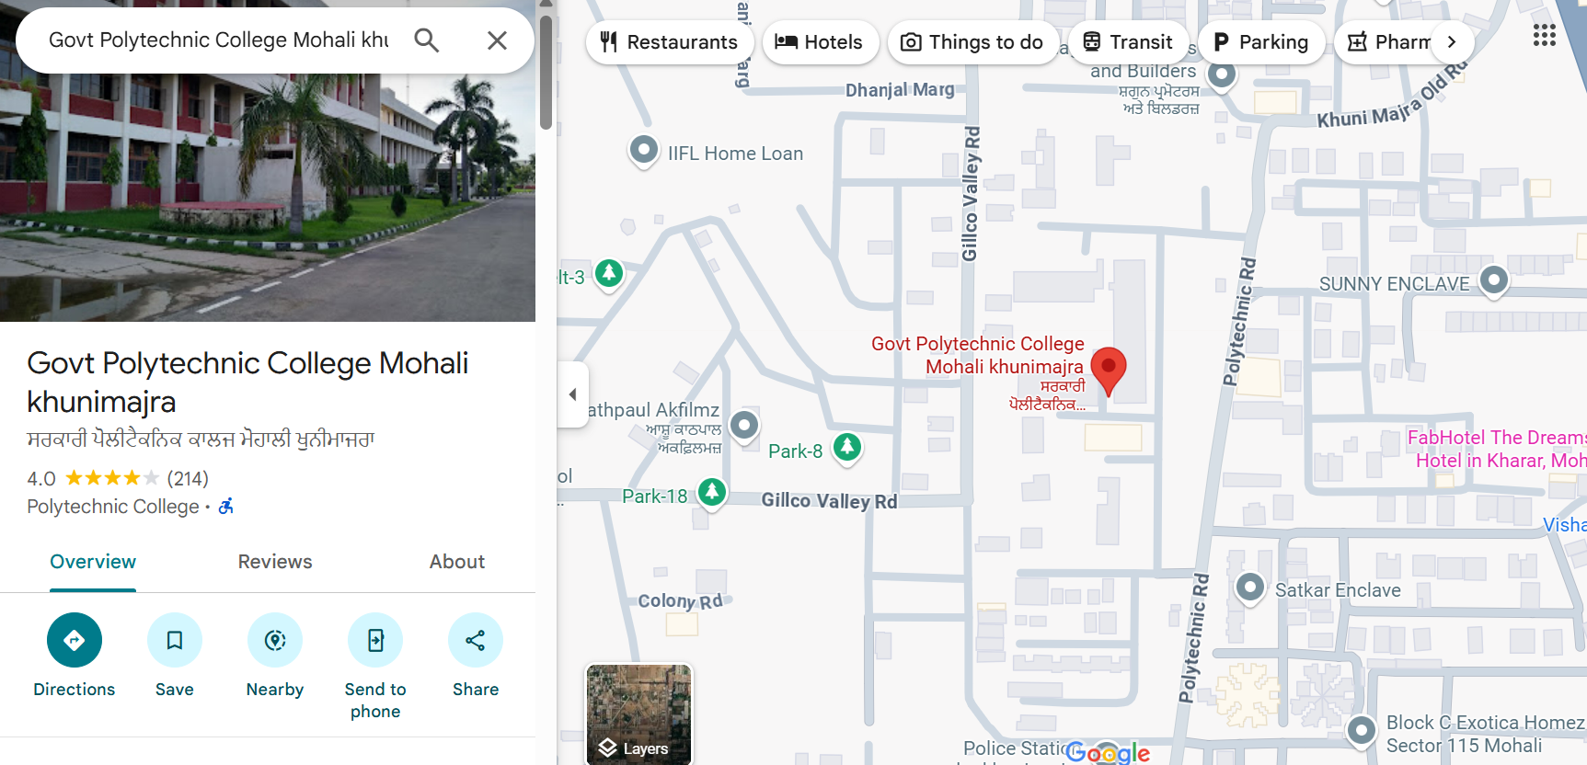
Thank you for your visit

